Slide 1
Trauma-Informed Care 101
Karen Heller Key
Heller Key Management Consulting
Jill Schumann
LeadingAge Maryland
LeadingAge DC Annual Conference
October 5, 2018

Slide 2
Ask yourself this question — when you hear the word trauma, what picture or image comes into your mind?

Slide 5
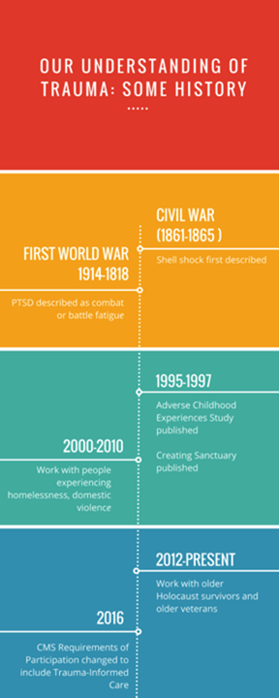

Slide 6
So What Exactly Is Trauma?
Trauma — individual trauma results from an event, series of events, or set of circumstances that is experienced by an individual as physically or emotionally harmful or life threatening and that has lasting adverse effects on the individual’s functioning and mental, physical, social, emotional, or spiritual well-being.
SAMSHA’s Concept of Trauma and Guidance for a Trauma-Informed Approach (2014)

Slide 7
How is that different from Traumatic Stress?
Traumatic stress refers to “the emotional, cognitive, behavioral and psychological experiences of individuals who are exposed to, or who witness, events that overwhelm their coping and problem solving abilities.”
In other words, a trauma, which produces traumatic stress, occurs when our coping mechanisms are overwhelmed by outside events.

Slide 8
HOW COMMON IS THE EXPERIENCE OF TRAUMA? Prevalence Data
While Americans once considered trauma to be a relatively infrequent occurrence, most research finds that a majority of us —between 55 and 90%— have experienced at least one traumatic event.
The ACEs study found that almost two thirds of respondents reported at least one adverse childhood experience.
Other potentially traumatic experiences include experiencing or witnessing:
Domestic and sexual violence
Natural disasters
Car, train and airplane crashes
Combat
Becoming a refugee
Homelessness
Medical trauma
Violent crime
Bias and discrimination
Hate crimes and hate speech

Slide 9
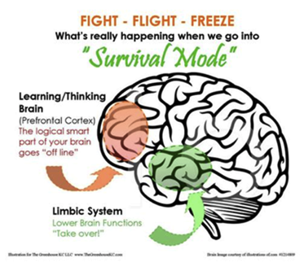
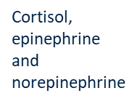
When confronted by external stimuli that are perceived as threats in the environment, humans react with a stress response.
What’s happening inside the brain

Slide 10
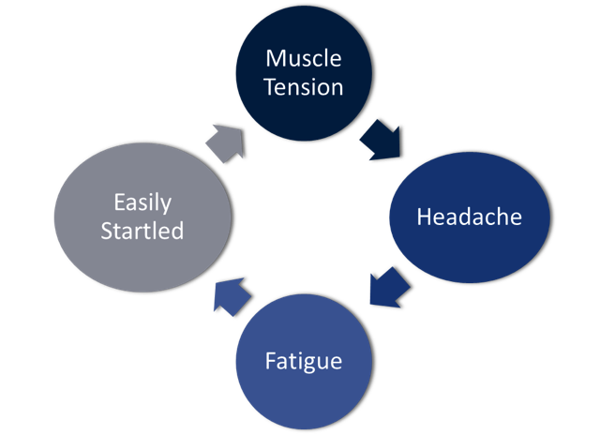
IMPACT OF TRAUMA ON THE BRAIN AND BODY

Slide 11
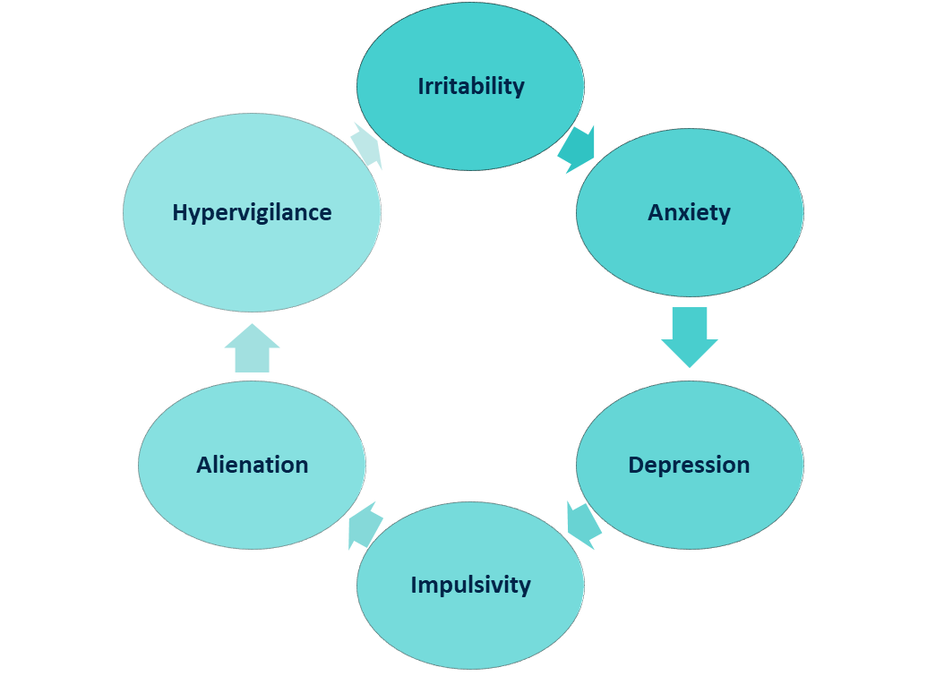
IMPACT OF TRAUMA ON THE BRAIN AND BODY

Slide 12
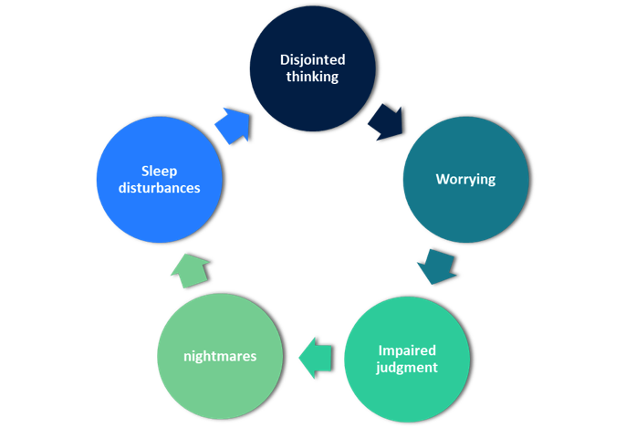
IMPACT OF TRAUMA ON THE BRAIN AND BODY

Slide 13
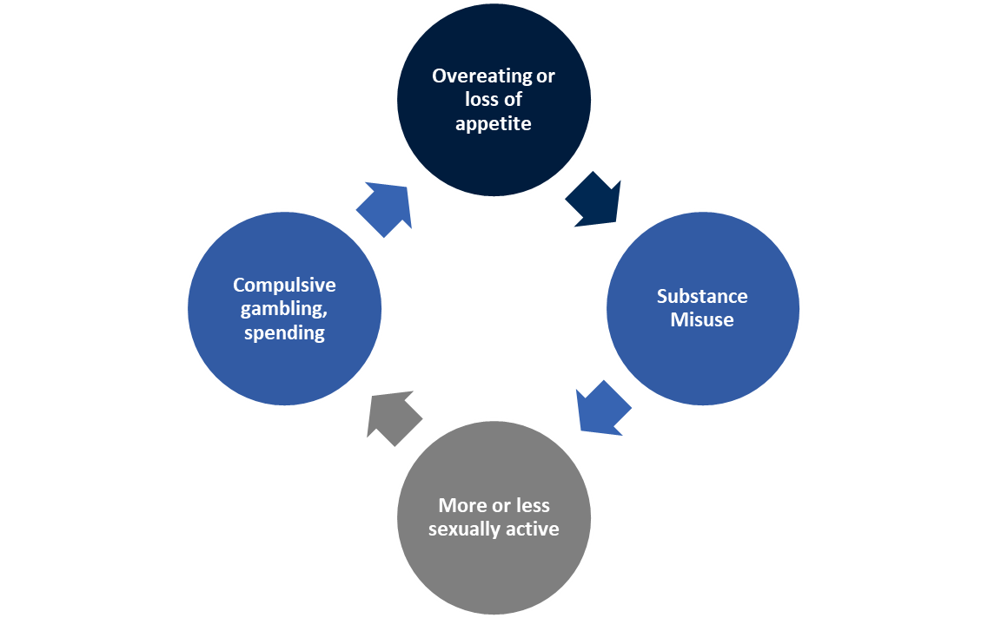
IMPACT OF TRAUMA ON THE BRAIN AND BODY

Slide 14
TRAUMA AND OLDER ADULTS: CONSIDERATIONS
Past adverse experiences
Current or recent traumas, including elder abuse or neglect
Traumas relating to the aging process
Loss of loved ones
Loss of own capacities
Loss of roles and identity and of home
Increased dependence

Slide 15
PUZZLING BEHAVIORS IN OLDER ADULTS

Slide 16
IF TRAUMA HISTORY ISN’T CONSIDERED… COMMON MISDIAGNOSISES
Dementia
Psychosis
Personality disorders
Mood disorders – bipolar, depression
Oppositional – willful misconduct
Hoarding is actually correlated to childhood physical or sexual abuse

Slide 17
CMS Requirements of Participation
In September CMS issued changes to the Requirements of Participation, to be implemented through a three stage process
Included policies designed to strengthen the provision of person-centered care to residents —a model in wide use across services for older Americans
Involves a holistic approach to meeting the needs of each individual resident
Considers psychosocial and spiritual aspects of well being in addition to physical health
Recognizes residents’ rights to care that is shaped to meet their preferences and goals to the greatest extent possible

Slide 18
CMS Requirements of Participation
To provide this kind of care to all residents, we must be equipped to understand and work with the circumstances, needs and wishes of people from a wide variety of backgrounds and lived experiences
New RoPs include an emphasis on providing services that are culturally competent and trauma-informed
CMS has pointed nursing home leaders the 2014 publication SAMSHA’s Concept of Trauma and Guidance for a Trauma-Informed Approach
Trauma-informed care is a relatively new discipline for nursing home communities

Slide 19
What is trauma-informed care?
Trauma-Informed — a program, organization or system that is trauma-informed realizes the widespread impact of trauma and understands potential paths to recovery, recognizes the signs and symptoms of trauma in clients, families, staff and others involved with the system; and responds by fully integrating knowledge about trauma into policies, procedures and practices to actively resist re-traumatization.

Slide 20
THE 4 “R’s” of a Trauma Informed Approach
Realization — all those involved in your organization at all levels realize that:
Trauma can affect individuals, families, organizations and communities
People’s behaviors can be understood as coping strategies designed to survive adversity and overwhelming circumstances (past or present)
Recognition — all those involved in your organization are able to recognize the signs of trauma and have access to trauma screening and assessment tools
Responding — your organization responds by applying a trauma-informed approach to all aspects of your work. Specifically, everyone on staff in every role has changed their behaviors, language and policies to take into consideration the experiences of trauma among residents, their families and staff
Resisting retraumatization of residents and staff members by ensuring that practices do not create a toxic environment — for example understanding the impact of using restraints or seclusion on a resident with a trauma history

Slide 21
But we’re a nursing home community,
not a counseling center!
Trauma-Specific Treatment
vs.
Trauma-Informed Care

Slide 22
Trauma-specific services
Refers to evidence-based and promising prevention, intervention, or treatment services that address traumatic stress as well as any co-occurring disorders (including substance use and mental disorders) that developed during or after trauma.
Trauma-informed care
Trauma-informed care is a strengths-based service delivery approach “that is grounded in an understanding of and responsiveness to the impact of trauma, that emphasizes physical, psychological, and emotional safety for both providers and survivors, and that creates opportunities for survivors to rebuild a sense of control and empowerment”
Also involves vigilance in anticipating and avoiding institutional processes and individual practices that are likely to retraumatizes individuals who already have histories of trauma, and it upholds the importance of consumer participation in the development, delivery, and evaluation of services.
(SAMSHA, 2014)

Slide 23
Trauma-Informed Care
at the
Individual and Organizational Levels
What is the end goal?
The whole organization — why?
Other than residents, who else is included?

Slide 24
Trauma-Informed Care
at the
Individual Level:
Three Core Principles
Principle 1: The impact of adversity is not a choice
Principle 2: Understanding adversity helps us make sense out of behavior
Principle 3: Prior adversity is not destiny

Slide 25
Trauma-Informed Care
at the
Individual Level:
Three Core Practices
Asking about and screening for trauma
Identifying triggers
Deescalation

Slide 26
The Six Key Principles of a
Trauma-Informed Approach
Safety
Trustworthiness and Transparency
Peer Support
Collaboration and Mutuality
Empowerment, Voice and Choice
Cultural, Historical and Gender Issues

Slide 27
Please consider – and then talk with someone seated near you about — the following questions:
Where do you see trauma in your facility – with residents and/or staff?
What is — or could be — in place to help with that?
Are there issues you think might be related that haven’t yet figured out how to resolve?

Slide 28
Six Key Steps on the Trauma-Informed Care Journey
Step 1: Ensure senior leadership commitment
Step 2: Appoint and empower a task force
Step 3: Launch at a kickoff event and initial training
Step 4: Conduct an organizational assessment
Step 5: Involve residents, families and community partners
Step 6: Provide ongoing training and supervision

Slide 29
LeadingAge Maryland Resilience for All Ages
Resilience for All Ages – specializing in trauma-informed care for older adults in a variety of settings
Partnering with LeadingAge to make resources available to LeadingAge members
Developing state partnerships to offer resources to non-members

Slide 30
Resources from LeadingAge & Resilience for All Ages
For LeadingAge Members:
Now on the Learning Hub –Foundations of Trauma-Informed Care Toolkit
Foundations of Trauma-Informed Care: An Introductory Primer (for boards & leadership staff)
Six one-page lessons to be used with all staff
Two slide presentations with notes: leadership level and all staff
Brief guide to use of the toolkit

Slide 31
Coming:
RFAA will provide a breakout session at the LeadingAge Annual Meeting in Philadelphia on Monday, October 29 – join us!
Trauma-Informed Care Implementation Guidebook:
Description of levels of implementation
Principles and practices of trauma-informed care
Forming an implementation team
Organizational assessment
Creating an implementation plan – outlining steps, responsibilities, resources, and timelines
Considering the differing needs of short stay and longer stay patients/ residents
Basic approaches to leading change
Statement of intent
Getting the board on board
Helpful relationships – behavioral health providers, employee assistance program, etc.

Slide 32
And…
Additional fee-based options:
RFAA adjuncts are available for onsite presentations training and consultation
Webinar series
Implementation – Level One Toolkit:
Essentials of creating safe environments and review of potential ethical issues
Building on organizational and individual strengths
Level One template policies
Level One -Putting trauma-informed principles into practice guidance
Implications for clinical and business partners

Slide 33
Finally…
Be alert to the sensitivity of these topics for both staff members and patients/residents
Be sure that Trauma-informed care fits well with patient/ resident-directed approaches
Be aware that well-implemented TIC creates a respectful and positive organizational culture for everyone

Slide 34
For additional questions and to keep the conversation going…
Karen Heller Key
karen@hellerkey.com
www.hellerkey.com
Jill Schumann
jschumann@leadingagemaryland.org
www.leadingagemaryland.org

