Slide 1
Recruiting, Engaging, and Retaining Tomorrow’s Workforce

Slide 2
LEARNING OBJECTIVES
Learn about our evolving industry and demographic trends impacting the workplace.
Learn about tactics to drive better outcomes related to:
Recruitment: Finding the Right People
Retention: Retaining the Right People
Engagement: Supporting the Right Culture
According to the American Community survey data used by Pew,
The wired, connected millennials are motivated differently.

Slide 3
Managing & Developing Others
LEADING & Developing Others
According to the American Community survey data used by Pew,
The wired, connected millennials are motivated differently.

Slide 4
KEEPING UP WITH OUR EVOLVING INDUSTRY

Slide 5
JUST THE FACTS
According to The Kiplinger Letter:
Forecasts for Executives & Investors
(dated 2/16/18)
The labor shortage is going to get even worse as 2018 unfolds.
There just aren’t enough able bodies to go around, especially as businesses seek to expand.
A whopping 56% of millennials report intentions to look for a new job within a year.
According to the American Community survey data used by Pew,
The wired, connected millennials are motivated differently.

Slide 6
JUST THE FACTS
According to the Society for Human Resource Management:
These Are the Hardest Jobs to Fill Right Now
(dated 2/28/18)
Two of the top 10 most in-demand positions in 2018 are projected to be home health aides and personal care aides.
The Bureau of Labor Statistics predicts that an additional 777,600 personal care aides will be needed over the next eight years.
The growth outlook for home health aides is nearly 50% over the next eight years.
According to the American Community survey data used by Pew,
The wired, connected millennials are motivated differently.

Slide 7
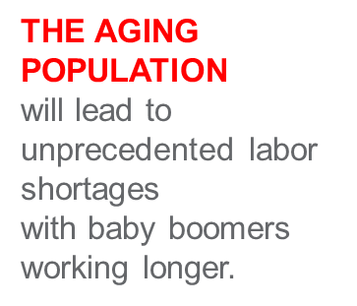
KEY WORKFORCE TRENDS IN THE U.S..
Today 1/3 are minorities.
Minorities will constitute a majority of the nation’s children under 18 by 2023 and of working-age Americans by 2039.
It is projected that by 2020, 81 percent of the new entrants into the workforce will be women or minorities.
According to the American Community survey data used by Pew,
81%
The wired, connected millennials are motivated differently.
The wired, connected millennials are motivated differently.
Hispanics comprise 16.4% of the U.S. population.
new entrants into the workforce

Slide 8
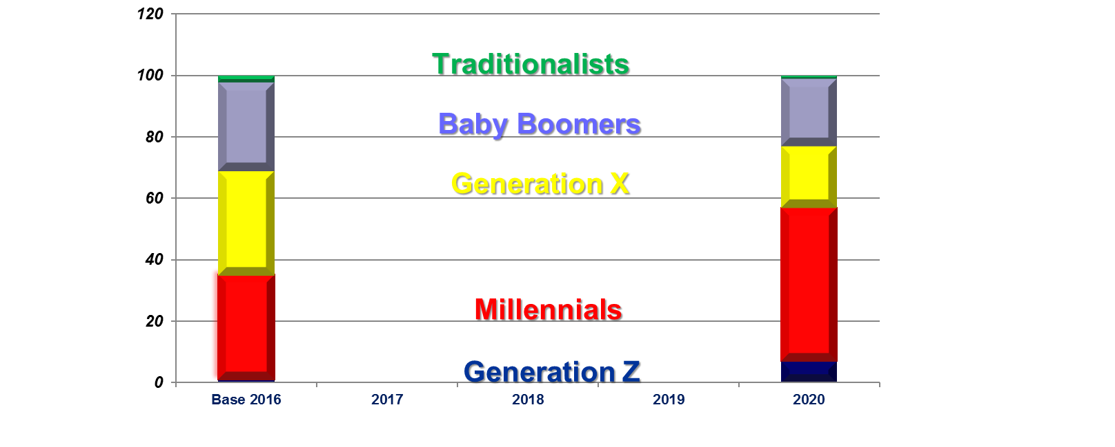
GENERATIONS IN THE WORKPLACE
According to the American Community survey data used by Pew,
The wired, connected millennials are motivated differently.
Hispanics comprise 16.4% of the U.S. population.

Slide 9
RECRUITMENT: FINDING THE RIGHT PEOPLE
Plan
Brand
Expand
VALUES
Skills
Experience
Education

Slide 10
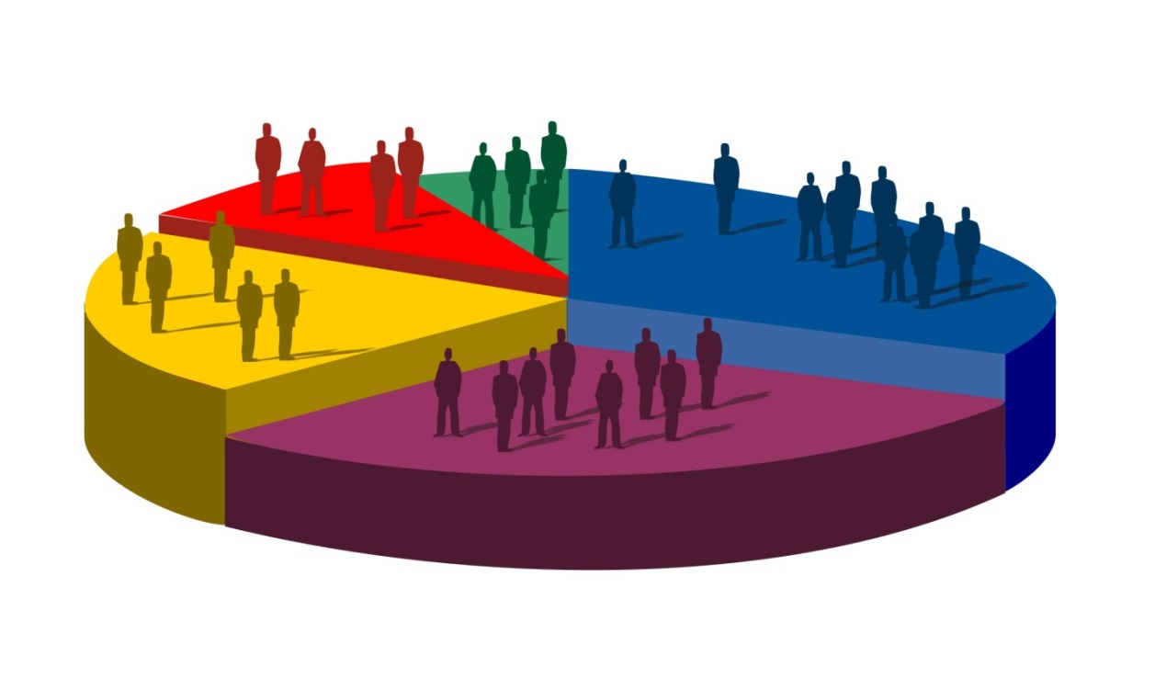
WORKFORCE PLANNING
Trends in Turnover
Diversity and Generational Mix
Internal and External Pipeline
Technical
Admin
Managerial
Frontline
Clinical

Slide 11
PROMOTING YOUR BRAND
What’s In the Message?
Is it Inclusive?
Can you personalize it?

Slide 12
EXPAND YOUR CAPABILITIES
Ease and Efficiency
Passive Candidates
Think outside of the Box
Looking in the Right Places

Slide 13
HIRING THE RIGHT PEOPLE
Behavioral Based Interviews
Attitude versus Skill
Referral Bonus
On-Line Applications (Mobil friendly)
Engaging the team not just leadership

Slide 14
RETAINING THE RIGHT PEOPLE BY ENGAGEMENT
Motivators
Communication
Direction
“Employee Engagement is a Consequence, not an Action”

Slide 15
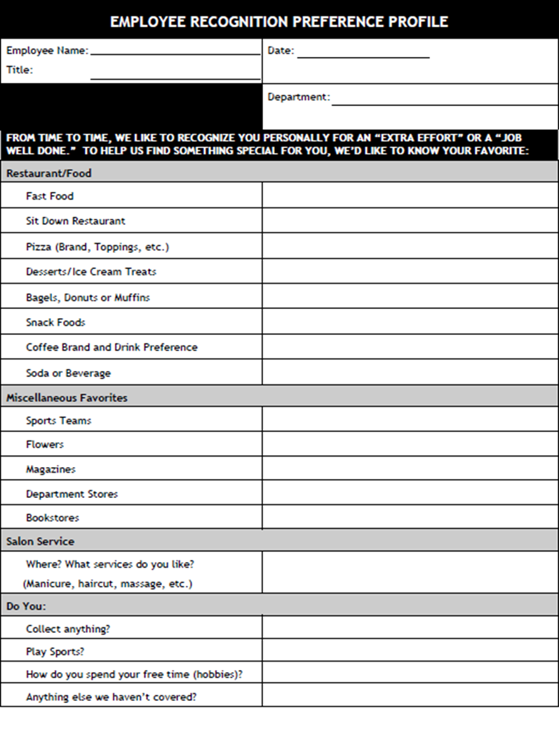
FIRST IMPRESSIONS MATTER
Red Carpet Treatment
Welcome Posters
Facebook Post
Welcome Letter (pre-orientation)
Welcome Aboard Cards
Employee Recognition Preference Profile

Slide 16
EMPLOYMENT MOTIVATORS
Tenure
Start with a Plan, spread experiences out over a 90 day period
Set Expectations Up Front (don’t oversell)
Build time in for meeting key people
Provide a “guide, coach or mentor”
Formal Feedback and revise, if needed

Slide 17
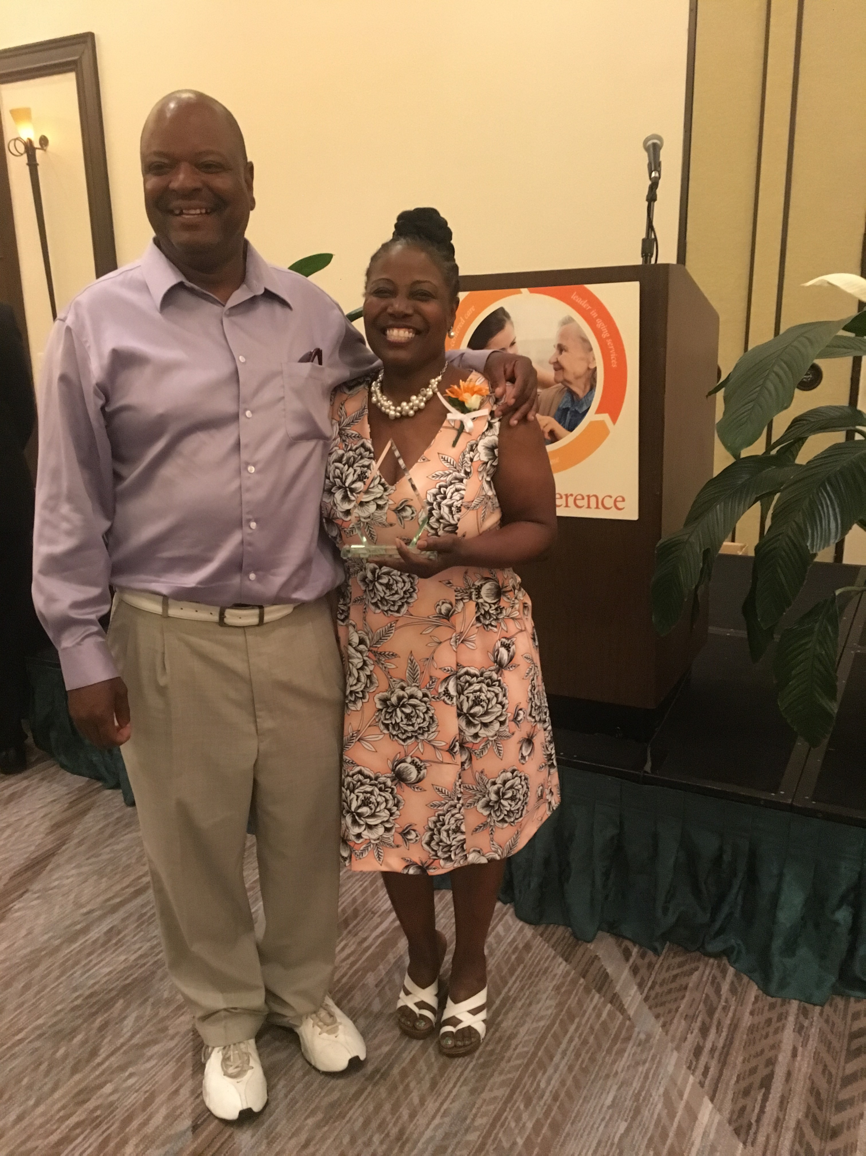
PEER MENTOR PROGRAMS
“In order to be a mentor, you should be able to give direction, be positive, and be mentally prepared to be a mentor. No jealously, gossip and not showing respect can be a part of the training.”
“Think about these things:
What do you do
What do you stand for
Why do you do it
In training you have to make sure that you have the self-confidence that is needed.”
“Love what you do until you can actually do what you love!”
-Daphne Jenkins, CNA
Leader of Peer Mentor Program

Slide 18
THE POWER OF STAY INTERVIEWS
The Power of Stay Interviews
www.C-SuiteAnalytics.com
A Stay Interview is a structured discussion a leader conducts with each individual employee to learn the specific actions he or she must take to strengthen that employee’s engagement and retention in the organization.
Why Stay Interviews?
Information that can be used today
Focuses on individual employees, including top performers
Places immediate supervisors in the solution seat
Notes:
Recognition
Investment
Opportunity

Slide 19
SAMPLE STAY INTERVIEW QUESTIONS
What do you look forward to each day when you commute to work?
What are you learning here?
Why do you stay here?
What phrase describes your average work day?
When is the last time you thought about leaving us? What prompted it?
What can I do to make your job better for you?
Have you had the opportunity to speak with your supervisor one on one since you started?
Notes:
Recognition
Investment
Opportunity

Slide 20
SUPERVISOR’S IMPACT ON EMPLOYEE ENGAGEMENT
“If you have a turnover problem, look first to your managers”…Gallup
Employees stay for managers first and co-workers second…salary.com
Employees’ levels of engagement are higher when their supervisors had higher levels of engagement…DDI
“When employees stay, it is because of their immediate managers”…National Education Association
Employees who stay primarily for their supervisors stay longer, perform better, and are more satisfied with their pay…TalentKeepers
Notes:
Recognition
Investment
Opportunity

Slide 21
SUPERVISORS VS. PROGRAMS
Good Programs + Good Supervisors =
Retention & Engagement
Good Programs + Poor Supervisors =
Turnover & Disengagement
Notes:
Recognition
Investment
Opportunity

Slide 22
VALUED COMMUNICATION
Talent / Career
Discussions
Operational
Input
Performance
Updates
Mentor Mentee
Notes:
Recognition
Investment
Opportunity

Slide 23
WORDS MATTER
We or Us versus Them
Manager versus Leader
Employee versus Team Member
Common message
Focus on culture
Notes:
Recognition
Investment
Opportunity

Slide 24
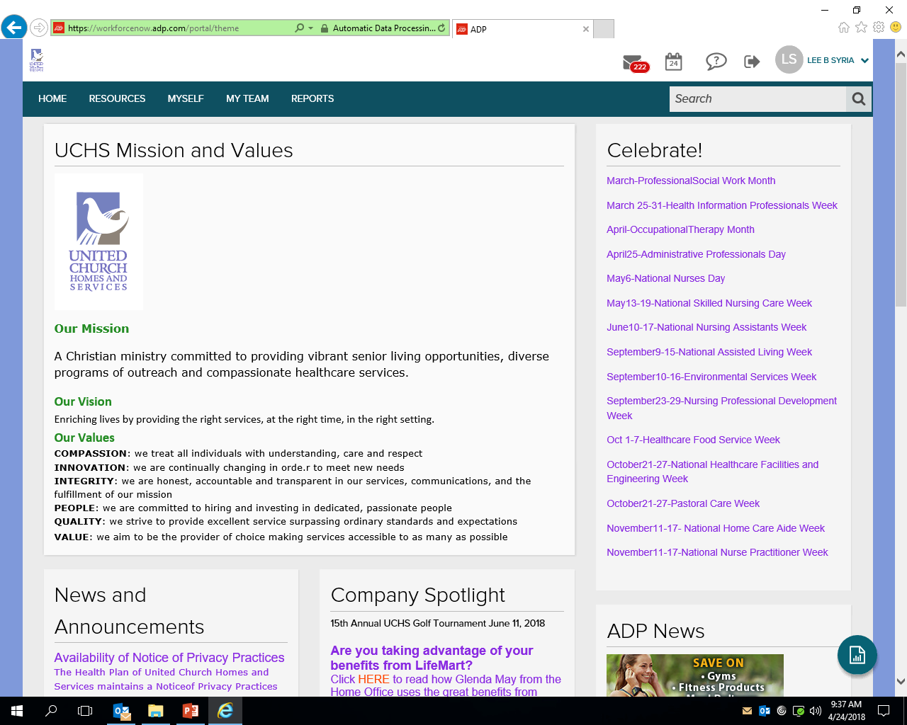
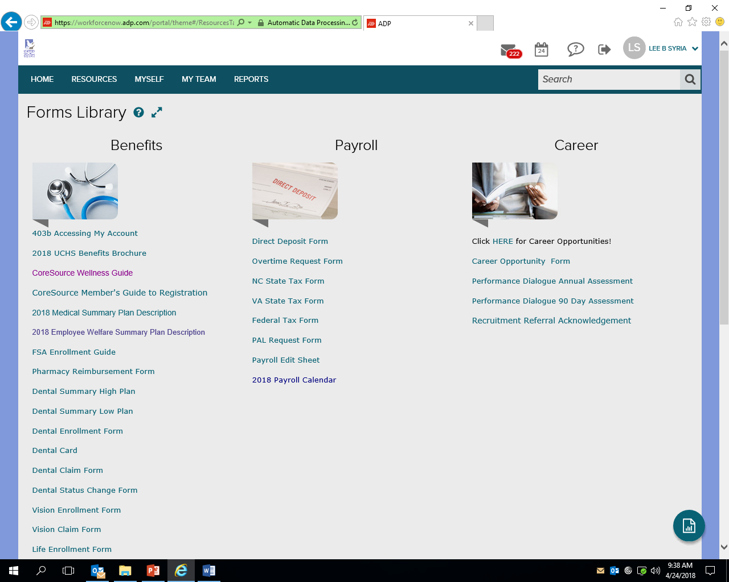
EMBRACE TECHNOLOGY
On-Line Learning
Employee Portal
Mobile Apps
Payroll
Benefits
On-Line applications
Social Media
Notes:
Recognition
Investment
Opportunity

Slide 25
MEANINGFUL DIRECTION AND EXPERIENCE
Notes:
Recognition
Investment
Opportunity

Slide 26
Thank You!
Notes:
Recognition
Investment
Opportunity

